Slide 1
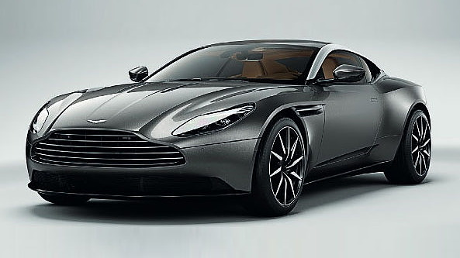
AR Car Customizer
COURSE PROJECT
18CSE304J- Building applications using opensource AR and VR SDKs
Created By :–
Pranav B Nair(RA2011003010023)
Debanjan Basak(RA2011003010606)

Slide 2
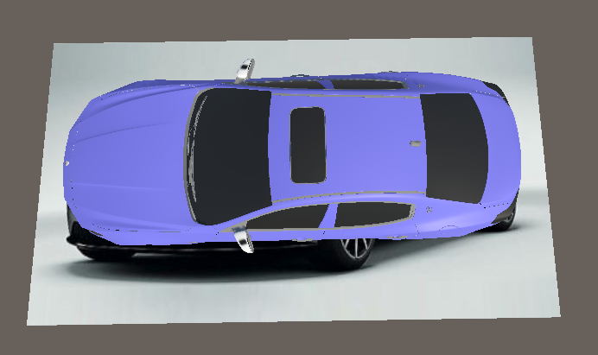
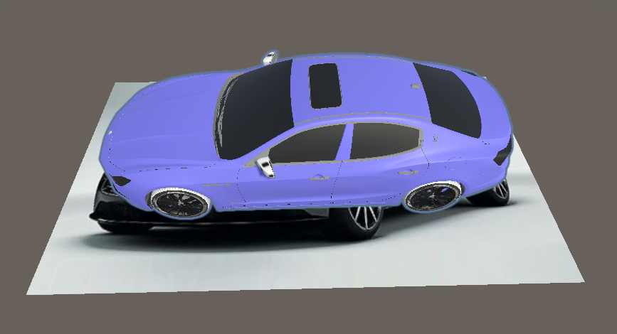
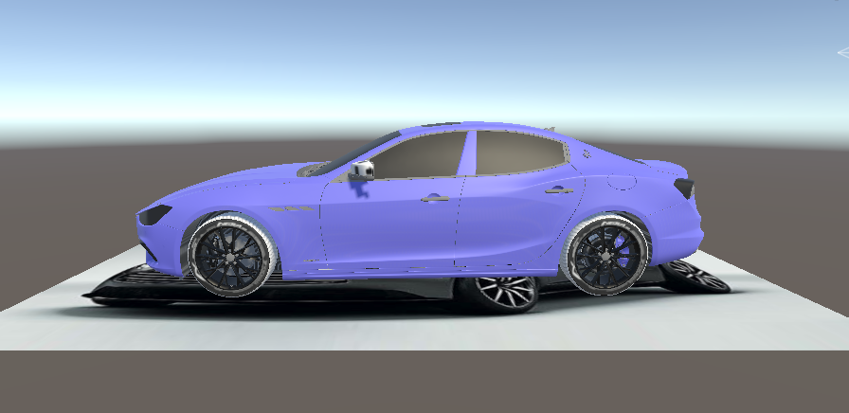
Introduction
The AR Car Customizer is a project that aims to revolutionize car customization by providing users with an immersive and interactive virtual experience.
The project uses ARVR techniques such as computer vision, machine learning, 3D modeling, and gesture recognition to allow users to experiment with different car parts and accessories.
By leveraging these technologies, the AR Car Customizer can make car customization more accessible, sustainable, and safe.
Overall, the AR Car Customizer project has significant potential to transform the way people buy and customize cars, making it an important and relevant topic in today's world.

Slide 3
Overview
The AR Car Customizer is an innovative project that revolutionizes car customization by providing an immersive and interactive virtual experience.
Purpose of the Application
Principles & ARVR Techniques
Procedure

Slide 4
Purpose of the Application
To allow users to customize their dream cars virtually in an immersive and interactive environment.
To provide users with an accurate representation of their customized car, with different configurations and styles.
To make car customization more accessible to a wider range of people, including those with disabilities or mobility issues.
To help users make more informed and sustainable car-buying decisions by experimenting with different features and configurations.
To provide educational opportunities by allowing students or aspiring car technicians to explore and experiment with car customization in a safe and virtual environment.
To showcase the potential of ARVR technologies and engineering principles in the automotive industry.

Slide 5
PRINCIPLES:-
ARVR Techniques
Target image detection
Vuforia SDK
Unity Hub
Canvas
Augmented Reality (AR)
Technology Mobile Application Development
3D Modeling and Animation

Slide 6
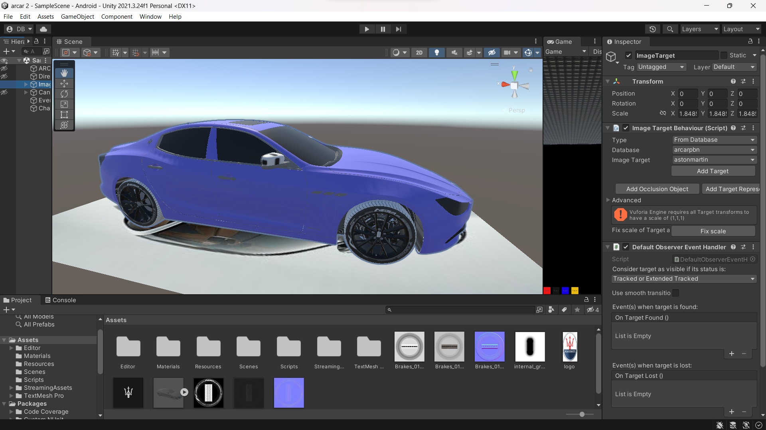
Procedure
1. Developed Scene in Unity :

Slide 7
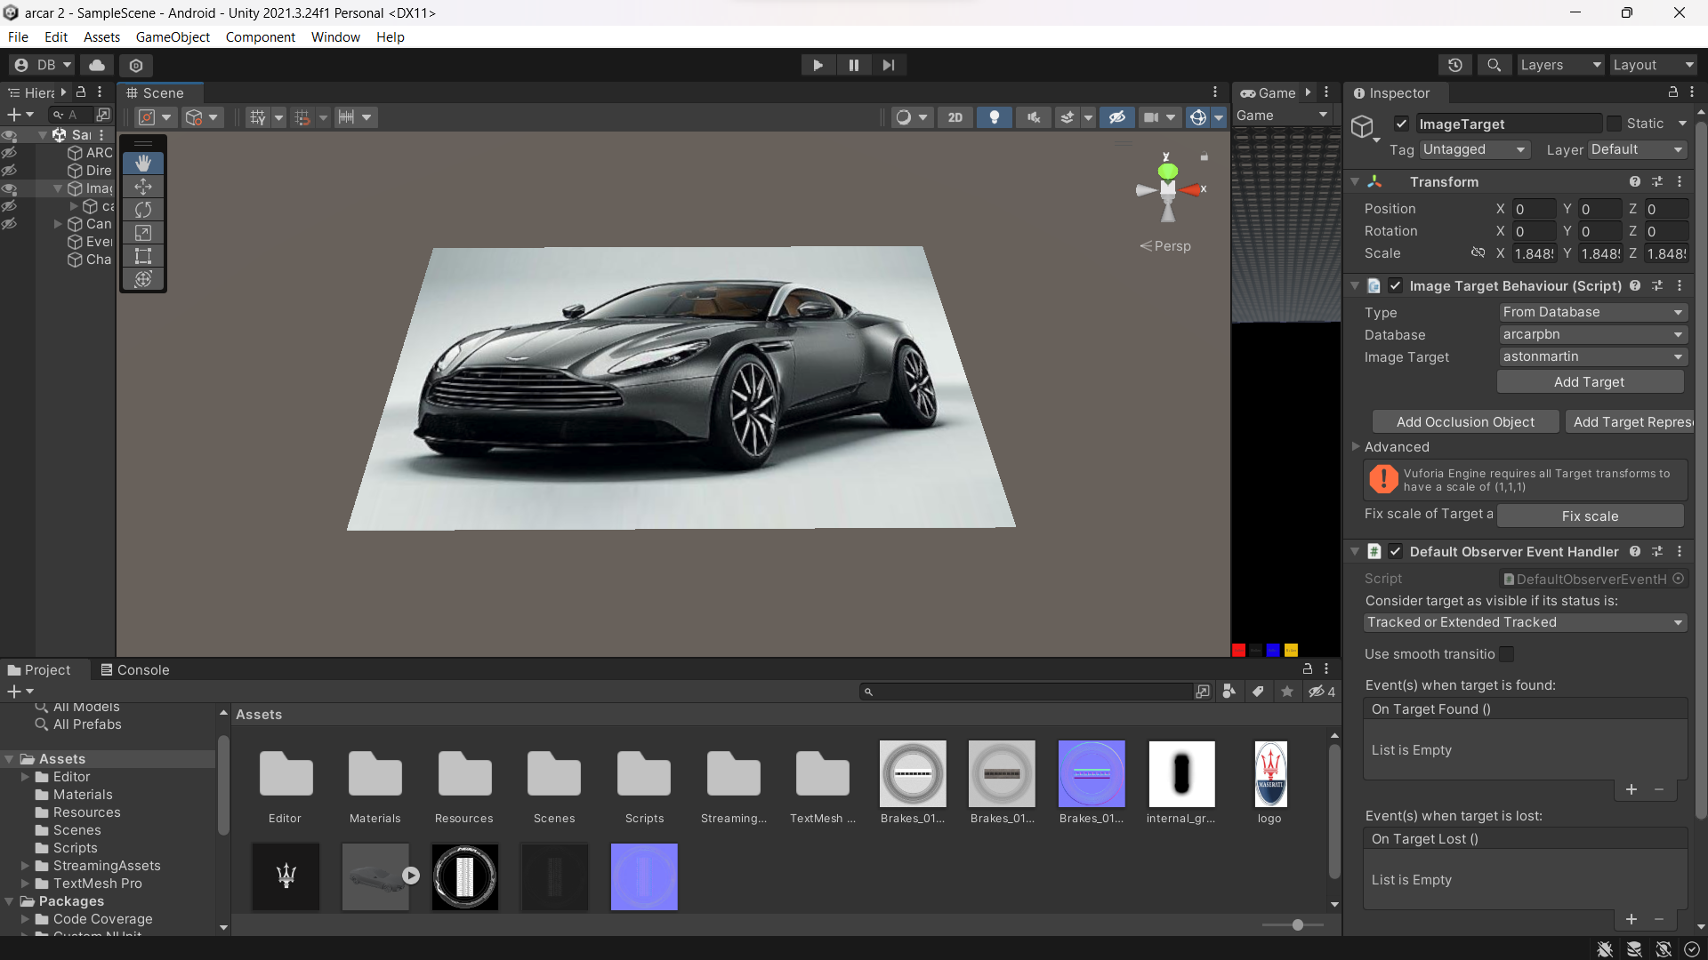
2. Added a target image using Vuforia :

Slide 8
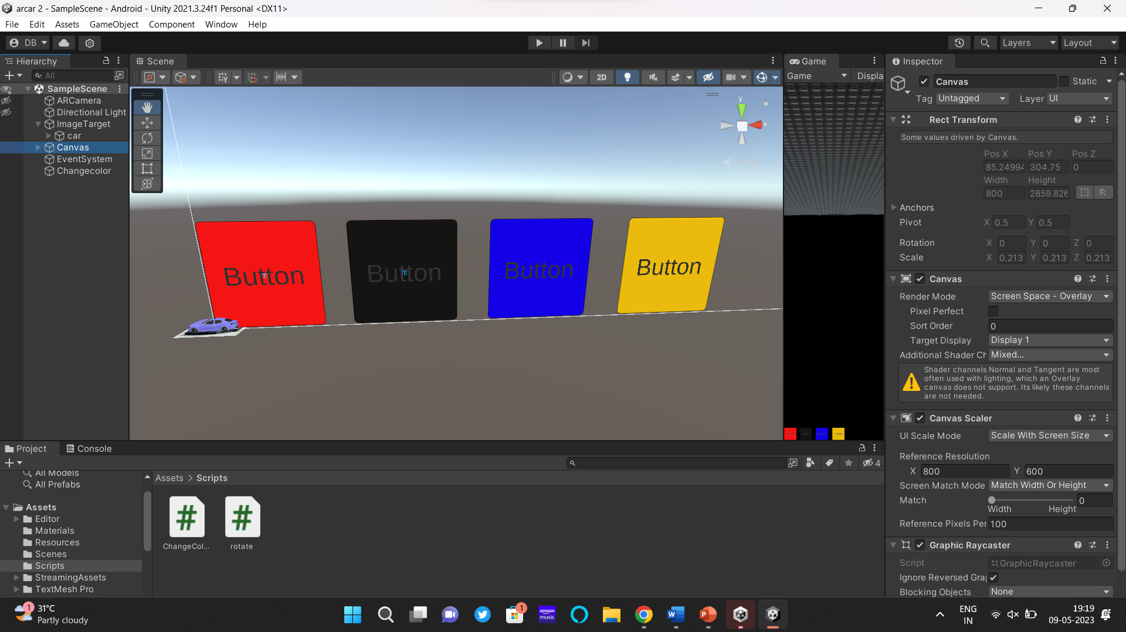
3. Added Canvas from UI items:

Slide 9
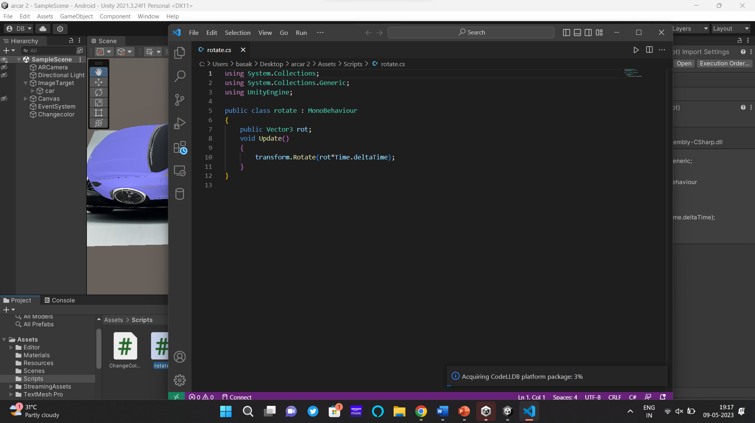
4. Added Script to rotate the car:

Slide 10
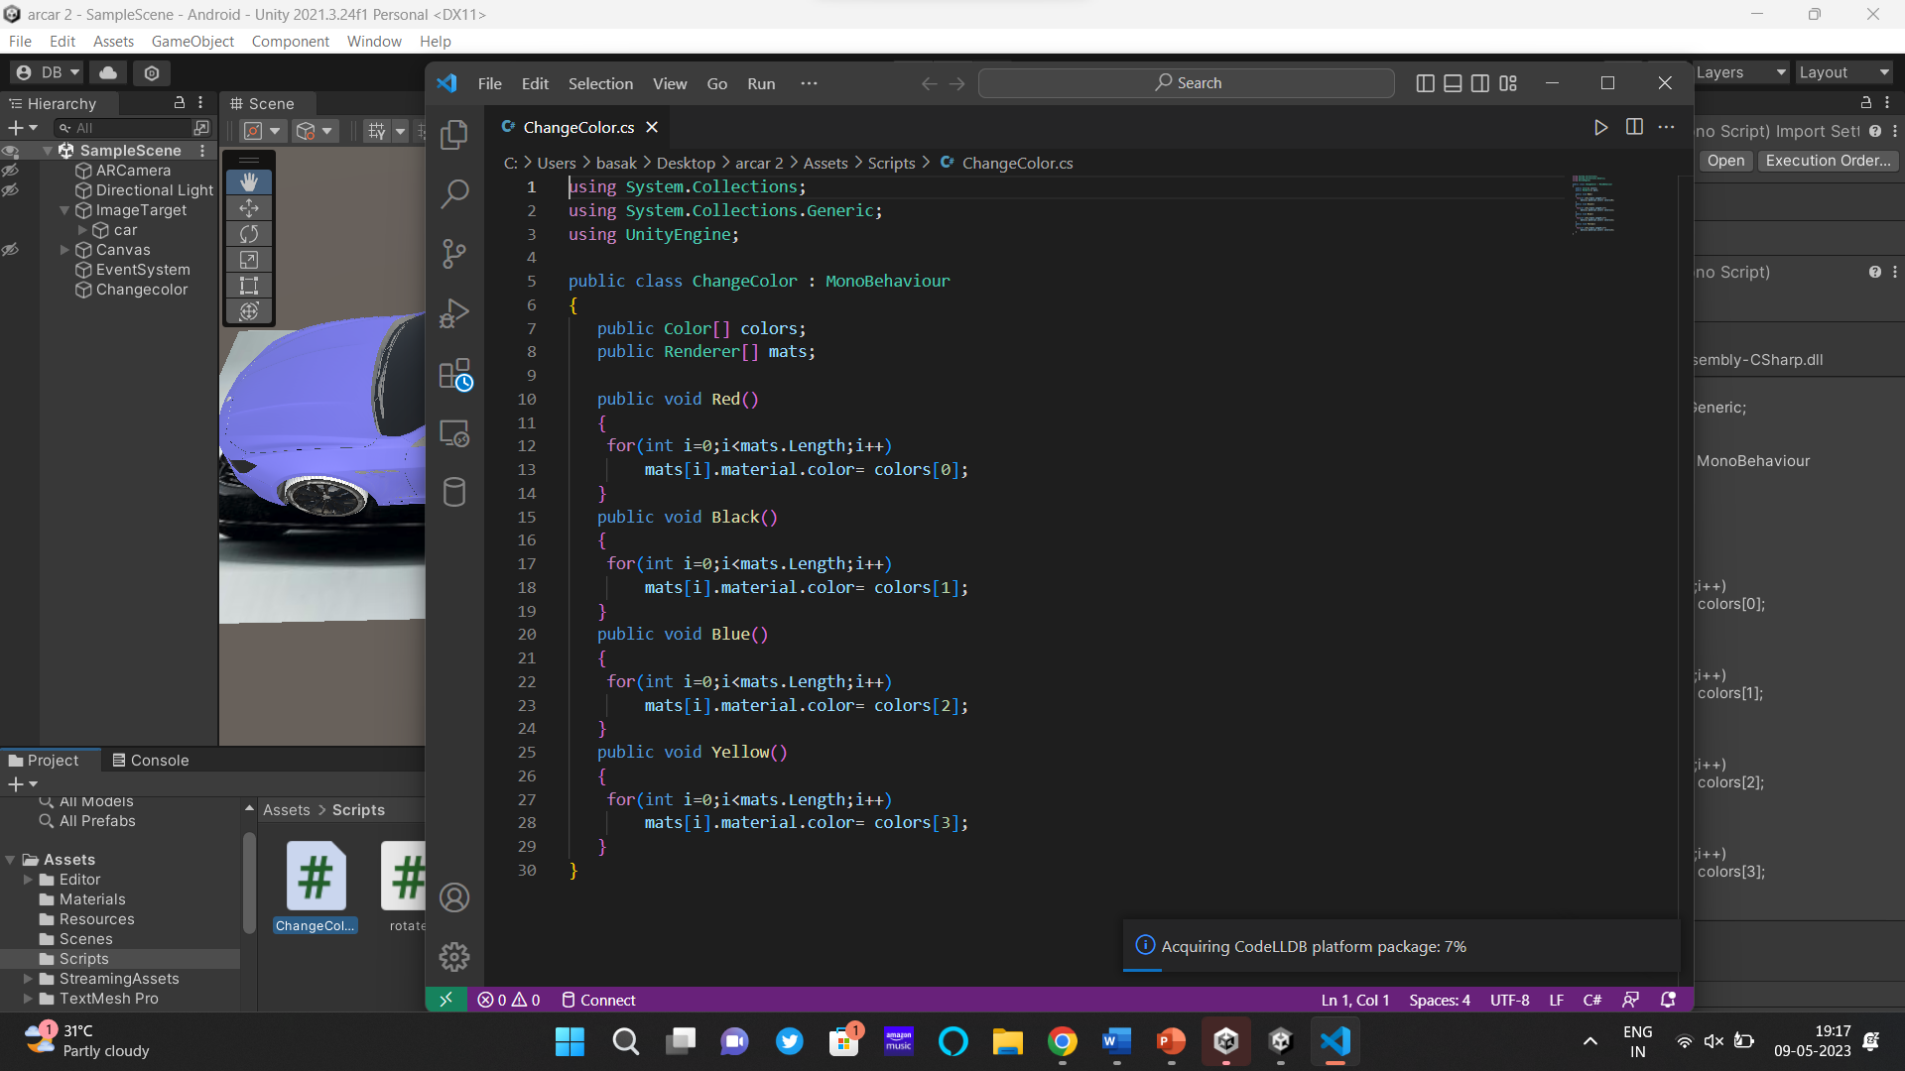
5. Added Script to change color of the car:

Slide 11
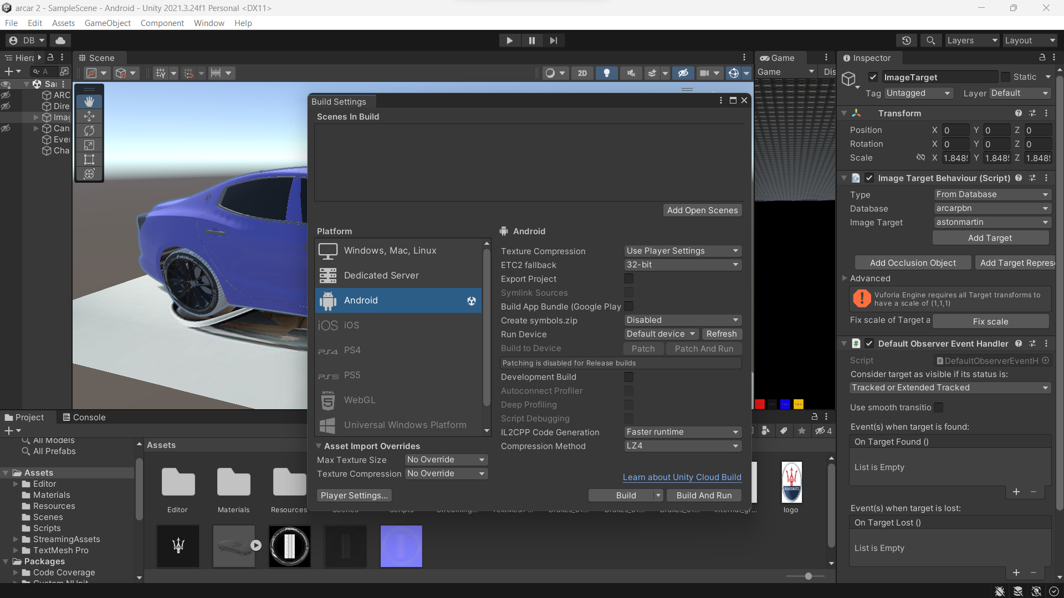
6. Build the Android SDK :

Slide 12
Thank you
Submitted by :-
Pranav B Nair(RA2011003010023)
Debanjan Basak(RA2011003010606)

